Slide 1

Predicting housing valuations in a volatile economy
Bhupesh Srivastava

Slide 2
Introduction
Goals
Predicting housing valuations in a volatile economy.
Help people and businesses make better financial decisions.
Creating a highly accurate model and interpret the results

Slide 3
Data Description
The dataset is from Sberbank with 30471 observations.
Split to 75% train, and 25% test
We used 12 variables from house intrinsic characteristics, 2 macro-economic variables, a time variable, and the property price.
Variable Name | Type | Description
Timestamp | String | Date of sale
full_sq | Numerical | Total square area including non-residential areas
life_sq | Numerical | Total square area excluding non-residential areas
floor | Numerical | Floor of the property
max_floor | Numerical | Max floor of the building
build_year | Numerical | Year the property built
num_room | Numerical | Number of residential rooms in the property
kitchen_sq | Numerical | Kitchen square footage
state | Numerical | State of property
material | Numerical | Type of material used in walls
product_type | Numerical | Either owner-occupied or investor property
full_all | Numerical | Neighborhood Population
usdrub | Numerical | Exchange rate of ruble to US dollar. Macro Data
unemployment | Numerical | Unemployment rate of the country. Macro Data
price_doc | Numerical | Price of property

Slide 4
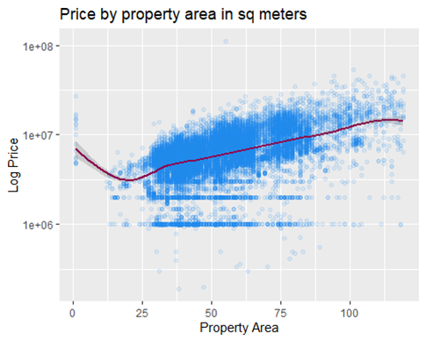
Explanatory data Analysis

Slide 5
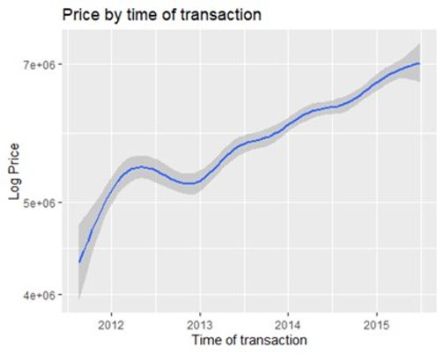
Explanatory data Analysis

Slide 6
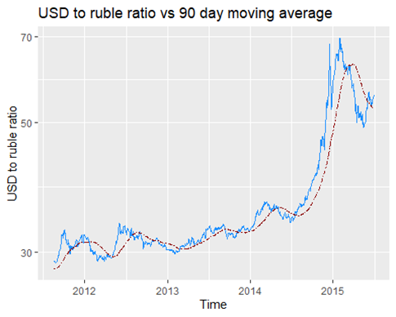
Explanatory data Analysis

Slide 7
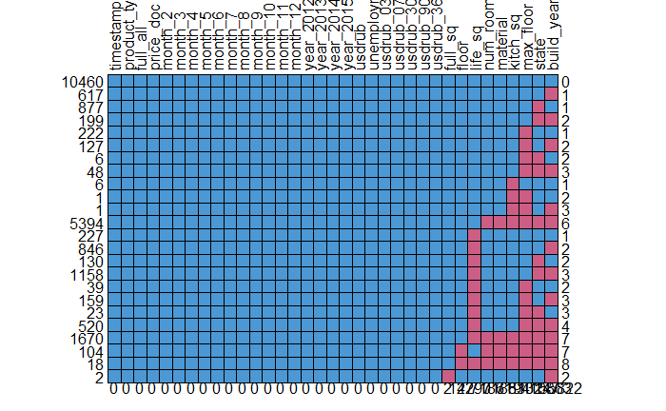
Imputation and Preparation
The data cleaning process was done during the EDA and anomalies were removed.
We impute the data set using Multivariate Imputation by Chained Equations(MICE) since missing values pattern is a case of multivariate missing values.
Used Predictive Mean Matching (PMM) as main imputation method

Slide 8
Explanatory model – Robust Regression
 | Value | Std. Error | t value
(Intercept) | -2.44e+07 | 1.55e+06 | -1.57e+01
full_sq | 1.94e+06 | 2.35e+04 | 8.27e+01
life_sq | -1.97e+03 | 3.93e+02 | -5.00e+00
floor | 4.03e+04 | 1.24e+03 | 3.23e+01
max_floor | 6.94e+04 | 1.31e+03 | 5.29e+01
build_year | 1.06e+04 | 7.81e+02 | 1.36e+01
num_room | -2.14e+05 | 9.89e+03 | -2.16e+01
kitch_sq | 1.23e+04 | 1.34e+03 | 9.12e+00
state | 3.29e+05 | 9.79e+03 | 3.36e+01
material | 1.02e+04 | 3.75e+03 | 2.72e+00
product_typeOwnerOccupier | -1.24e+06 | 2.49e+04 | -4.99e+01
full_all | -4.80e-01 | 4.59e-02 | -1.04e+01
The Max floor has a larger coefficient than the floor
Owner occupiers are paying less for the properties
Nonlinear relationship for neighborhood population

Slide 9
Explanatory model – Robust Regression
 | Value | Std. Error | t value
year_2012 | 3.14e+05 | 4.00e+04 | 7.86e+00
year_2013 | 5.85e+05 | 4.13e+04 | 1.41e+01
year_2014 | 8.10e+05 | 5.33e+04 | 1.51e+01
year_2015 | 5.91e+05 | 1.28e+05 | 4.59e+00
usdrub | -1.13e+04 | 1.08e+04 | -1.04e+00
usdrub_03da | 5.33e+04 | 1.89e+04 | 2.81e+00
usdrub_07da | -1.82e+04 | 1.47e+04 | -1.24e+00
usdrub_30da | -1.51e+04 | 9.47e+03 | -1.60e+00
usdrub_90da | 1.67e+04 | 6.53e+03 | 2.56e+00
usdrub_365da | 1.92e+04 | 7.47e+03 | 2.57e+00
poly(full_all, 2)2 | -9.68e+07 | 4.058e+06 | -2.38e+01
(full_sq * build_year) | -9.12e+02 | 1.17e+01 | -7.77e+01
(full_sq * full_all) | 1.05e-02 | 8.00e-04 | 1.30e+01
Yearly trend
Seasonality
Currency exchange rate, and its moving averages
Less desire for bigger houses in populated areas.
Buyers are paying more for smaller new houses

Slide 10
The Linear Model
We use linear regression as base prediction model.
Our evaluation metric is the sum of squared prediction errors.
Linear error is: 1.386539e+13
To make a better sense, the ratio of sum absolute errors divided by the total value of the property is 0.307.

Slide 11
Shrinkage Models
Ridge regression penalizes the coefficients by using L2-norm ( sum of the squared coefficients).
Lasso penalizes the regression model with a term called L1-norm(sum of the absolute coefficients)
Elastic Net is a combination of Ridge and Lasso.
Alpha | Error
[0] | 1.461248e+13
[0.1] | 1.454548e+13
[0.2] | 1.448947e+13
[0.3] | 1.435673e+13
[0.4] | 1.445017e+13
[0.5] | 1.457345e+13
[0.6] | 1.447969e+13
[0.7] | 1.440332e+13
[0.8] | 1.45336e+13
[0.9] | 1.483017e+13
[1] | 1.452096e+13

Slide 12
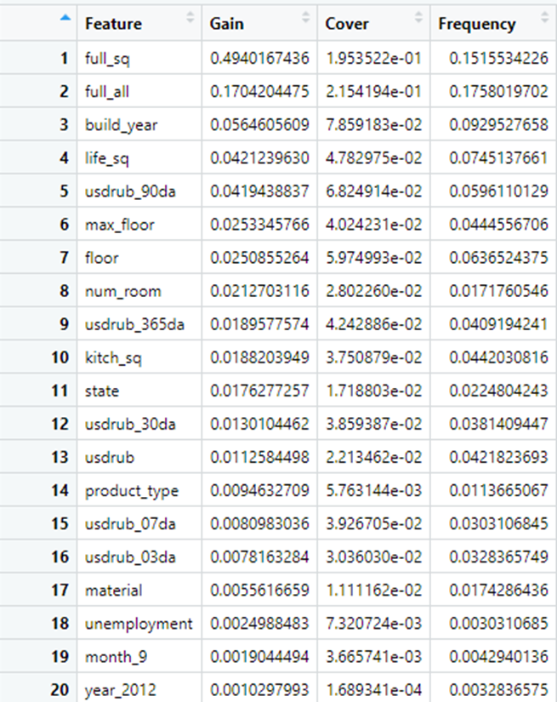
XGBoost
XGBoost is an implementation of gradient boosted decision trees.
It creates many trees and reduces the residuals in each new tree.
This model does not need any normalization and scaling and addresses these issues automatically.
Error 8.620462e+12
38 percent improvement

Slide 13
Conclusion
The linear model had a smaller residual error then the penalized models.
Penalized models most likely not efficient because of lack of columns or similar coefficients
The XGBoost allow more flexibility in complex relationships in the data and accounts for over fitting

Slide 14
Conclusion(Cont'd)
In our final predictive model, we found that variables Total area(49.4%), subarea population(17%), build year (5.64%), total built area(4.21%), dollar-ruble exchange rate(4.19%) are the most important
We got several insights into the relationships in the data with our explanatory models. Example :
Seasonality
State of property
Size compared to population
Etc..

Slide 15
The Future Applications
Our model can be used by various stakeholders or companies. These includes-
Banks and banking corporations
Individual buyers.
Real estate agencies
Construction companies/Developers
Insurance companies
Housing census bureau

